Slide 1

Task 11- Physics behind car safety features
By Jazmyn Fijac

Slide 2
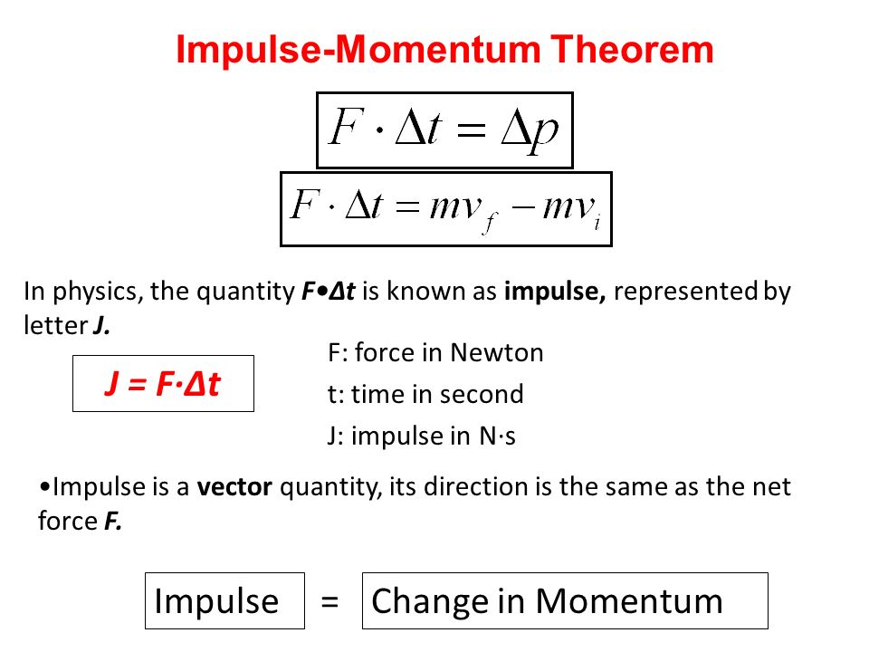
Increasing the time of the collision or the time the occupants take to stop
Formula
To minimize personal injury this principal to a car applies by having crumple zones that deform in response to an impact and absorb energy. In most cases, they are placed at the front and rear of a vehicle because this is where most collisions occur.
When a crumpled car is pushed, it does not bounce, reducing force and momentum. The car's collapse lengthens over time, altering its momentum. By expanding during the collision. This scheme can also be utilized to move the vehicle down in a frontal collision to reduce the likelihood of the motor entering the cabin. Because the engine is primarily a solid mass of steel that will not change shape well during an impact, it must be moved to enable the front crash framework to crumple properly.
The Impulse-Momentum Change Theorem states the impulse (force) applied to an object will be equal to the change in its momentum. An example of this theorem is A car traveling down the road is slowed down slightly when the brakes are just gently tapped. The force of the brakes is exerted over a small time resulting in a small impulse and a small change in the momentum of the car.

Slide 3
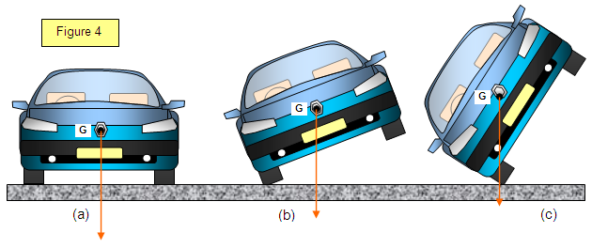
Spreading the forces of impact over the largest possible area & ensuring stability of the vehicle.
All the force generated during an impact must go somewhere, and the goal is to direct it aside from the passengers. Everything that occurs to the car during an impact, as well as everyone who is inside the vehicle during the time of the impact, uses up some of the force. Consider how much force is required to bend a car's steel frame. Because that much force is spent bending the frame, it is never transferred to the occupants. Crumple zones are built around this idea. Parts of the car are designed to be affected, crumpled, smashed, and broken by having unique structures inside them. The basic idea is that it ends up taking force to harm them. Crumple zones apply as much force as possible to ensure that other parts of the car, as well as the occupants, are not affected.
Some car components simply cannot crumple. The motor is the major culprit; in most cars, the engine is a massive, bulky block of steel. There's no crumpling there. The same is true for vehicles powered by aluminum engine blocks. Cars may need to be redesigned in order to include a greater crumple zone. However, this can also cause issues; for example, if the engine is forced back into to the passenger cabin as a result of the impact, it can cause serious injury. It takes energy to crush and deform components, a portion of the energy expended in a collision is managed to spend deforming the crumple zones and crash boxes, reducing the overall kinetic energy of the impact. Both work together to keep the passengers safe.
Say for example you're driving at 50 mph, and you collide with another vehicle, the car that got hit will still be moving at the same speed but the crumple zones on the car will help with transferring the car’s kinetic energy into controlled deformation or cumple at impact.
Cars lower to the ground helps the cars stability by using lighter materials for the vehicle and when a person is driving a car at a high speed its easier to control when a car is lower to the road than a 4wheel drive car for example. A lower centre of gravity helps the cars suspension and able to handle the car easier, it also keeps the car stable on the road.

Slide 4
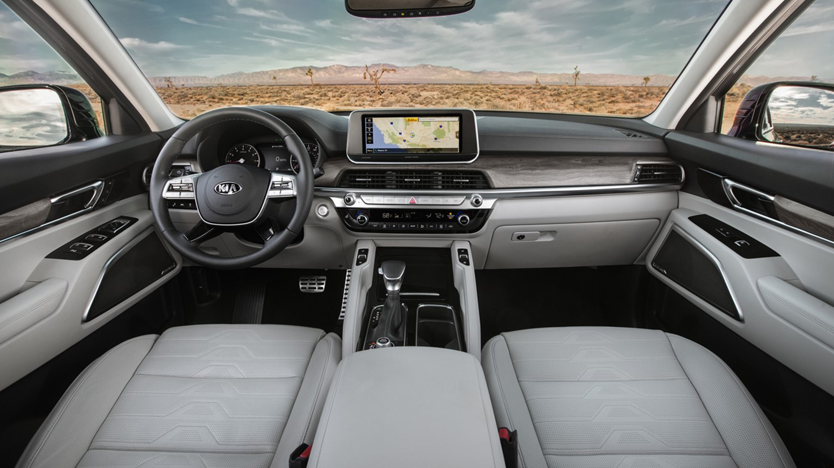
Minimizing contact of the person with the interior of the vehicle
Car occupants' head injuries in accidents on Australian roads are a leading cause of death and permanent brain damage. Preventing head impacts and reducing the severity of those that do occur has the potential to save many lives and alleviate lifelong suffering for brain-damaged individuals and those who must care for them. This report assesses the advantages that are likely to result from the use of padding components to reduce the symptoms of a head impact. Airbags especially help you from banging your head on the dashboard if you collide with another vehicle.
Seat belts: law of inertia- Newton's first law states that every object will remain at rest or in uniform motion in a straight line unless compelled to change its state by the action of an external force. The formula is F = ma (force = mass x acceleration). If the car has a force acting upon it, friction will eventually stop the car from moving which stops person from flying out.

Slide 5
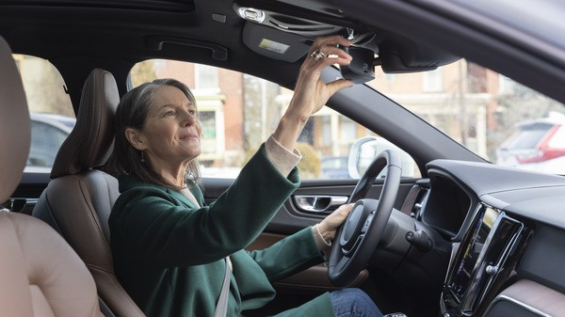
Keeping the person inside the vehicle
To keep a person inside a vehicle when a crash occurs, the car is installed with several air bags. When a collision is detected, the airbag deploys. It inflates quickly and provides a padded area for the occupants' body parts to impact. This not only protects the occupant from being hit by the car's interior, but also lengthens the time it takes to decelerate, lowering the force applied on the individual. The duration is extended due to of deformability of the airbags. The occupant who hits the cushion is gently slowed down by the changing changes in resistance force supplied by the cushion. When compared to striking the dashboard or steering wheel, it further slows the individual down much more gradually. Strenuous forces acting on the human body can cause internal organ damage.
Airbags are commonly assumed to be located only on the steering wheel and the passenger seat of the dashboard, but this isn't the case. Many modern automobiles now have up to six airbags in the cabin. These can include knee airbags, door airbags, and curtain airbags.
When an airbag is released, the force pushes out to keep the person from injuring themselves quite badly and equation for an airbag released is 2 NaN₃ --> 2 Na + 3 N₂

Slide 6
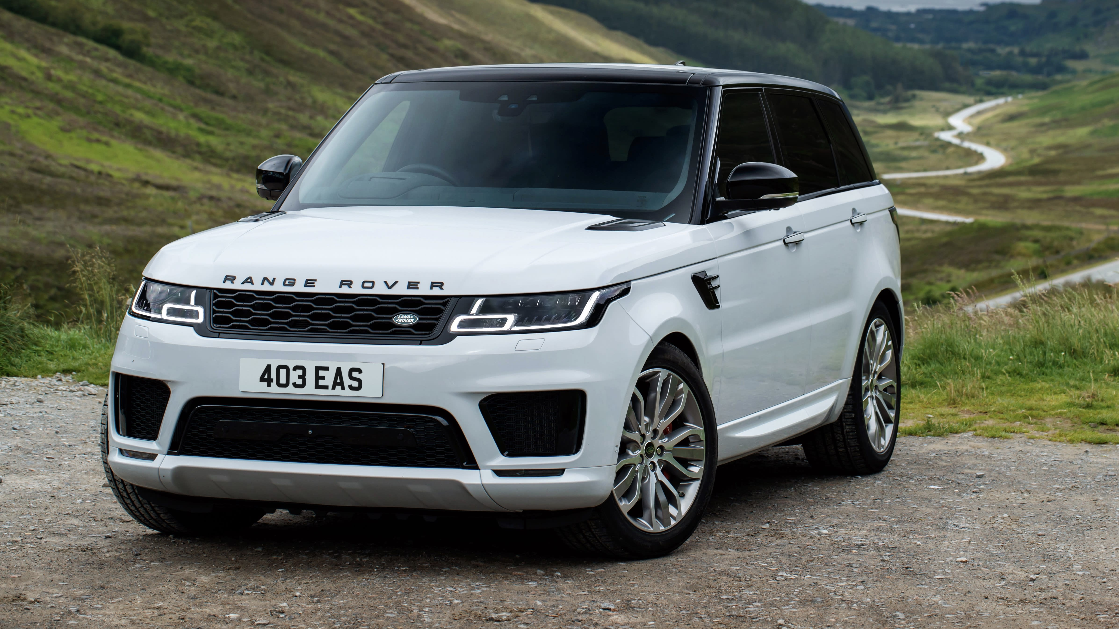
2021 Range Rover safety features
Autonomous braking system
Front impact airbags
Side Impact air bags
Stability control
Blind spot warning
High speed emergency braking

Slide 7
Each safety feature that relate to the physics principals
Autonomous braking system- principal A
Front impact airbags- principal C
Side Impact air bags- principal D
Stability control- principal B
Blind spot warning- Principal A
High speed emergency braking B

Slide 8
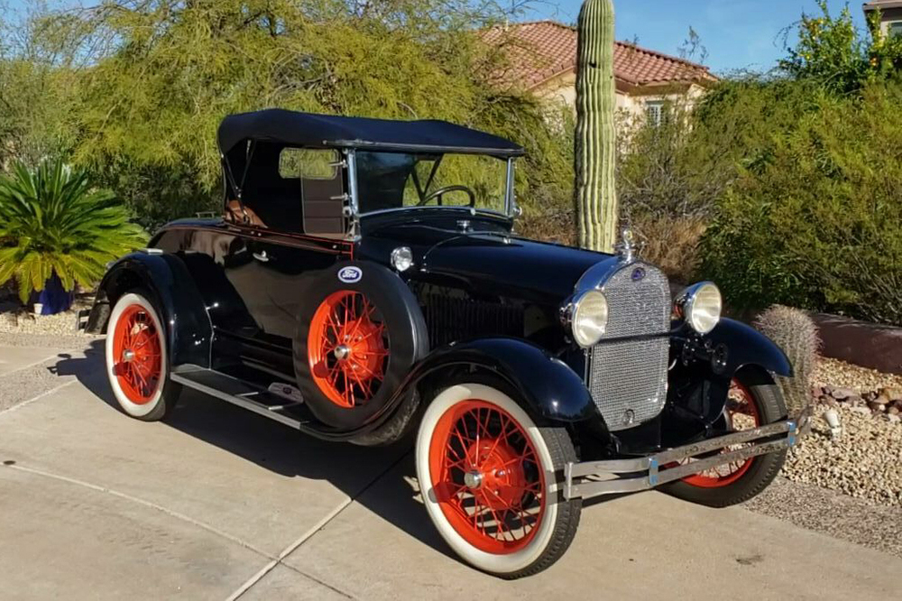
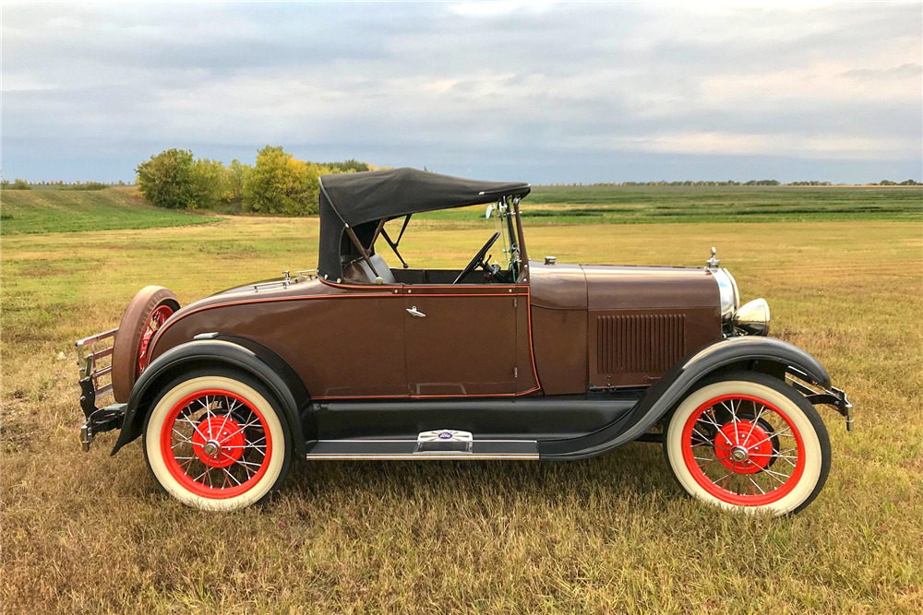
1929 Ford Model A Roadster unsafety features
The crumple zones on the car will cause drastic impact to the vehicle
No visible airbags
The roof is flimsily and could break in certain weather conditions
The wheels are quite thin
No side mirrors (optional to add)
Spare tire on the side or on the back of the car which is quite dangerous
Seatbelts only go over the waist of the occupant

Slide 9
Each unsafety feature that relates to the physics principals
The crumple zones on the car will cause drastic impact to the vehicle- Principal A
No visible airbags- principal C
The roof is flimsily and could break in certain weather conditions- principal D
The wheels are quite thin- principal B
No side mirrors (optional to add)- principal B
Spare tire on the side or on the back of the car which is quite dangerous- Principal B
Seatbelts only go over the waist of the occupant- principal D

Slide 10
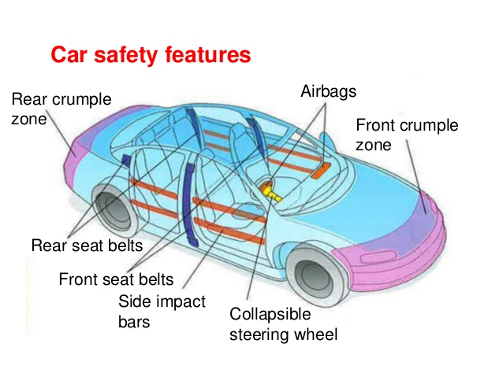
the role of safety in a car design
The role of safety in a car is to make sure people driving on the road feel safe and secure by manufacture when designing a car will install multiple air bags and other safety features to prevent car accidents/ the person.

Slide 11
Improvements for safety features in cars
Having more airbags installed not just in the front part of the car also at the back of the car where most children sit
Every car should have an anti-locking braking system (ABS) to help control the vehicle on slippery roads.
Lane keeping assist and cruise control to ensure the car can stay at a constant speed to collide with any other cars and for the vehicle to stay in their lane on a highway to avoid accidents
A button in a car where you can put on for obstacle detection to warn you there’s something in the way
An installed drowsiness button to keep drivers from driving on the road when they’re tired or under the influence of alcohol

